Slide 1
Webinar on Staff circumstances in REF 2021
Follow us on Twitter
@REF_2021
Email us: info@ref.ac.uk
Professor Dianne Berry OBE (Chair of EDAP)
Dr Catriona Firth (Head of REF Policy)
February 2019

Slide 2
Introduction and overview
Background
Applicable circumstances
Processes for supporting staff
Reduction requests
Removal of min. one requirement
Unit reductions
Circumstances report

Slide 3
Equality and diversity in REF 2021
Funding bodies are committed to supporting and promoting equality and diversity in research careers.
There are many reasons why an excellent researcher may have fewer or more outputs attributable to them in an assessment period.
It is not expected that all staff members would be returned with the same number of outputs.
We expect that the flexibility offered by decoupling will be reflected in institutions’ expectations of individual researchers.
Funding bodies have put in place processes to recognise the effect that an individual’s circumstances may have on their productivity.

Slide 4
Consultation feedback
Very mixed agreement levels – more pronounced for HEI responses
Wide support for min. of one reduction

Slide 5
Consultation feedback
Widely-raised concerns about extent to which proposals would achieve aim – under-representation of protected groups in output pool
Potential effects for individual staff
Pressure to declare sensitive information
Excluded from output pool
Compatibility with 2021 framework and decoupling
Potential for gaming

Slide 6
Principles
The funding bodies and EDAP were guided by the following principles when revising the proposal:
Ensure there is recognition of the effect circumstances can have upon individual researcher productivity – and therefore their ability to contribute to the pool of outputs at same rate as other staff.
Create the right incentives for supporting staff with circumstances (and not introduce e.g. negative incentives around recruitment).
Recognise the potential disparity in the available output pool for units in particular contexts, for example where there are high proportions of staff with circs, or for very small units.
Maintain the integrity of exercise – both in supporting E&D and ensuring the credibility of assessment process.

Slide 7
Staff circumstances mechanisms
Greater focus on HEIs’ responsibility to support individuals with circumstances
Safe and supportive structures to enable voluntary declaration
Adjust expectations of individual’s contribution to the output pool
Unit reductions as separate – optional – step where cumulative effect of staff circumstances has impacted on the output pool
Request for removal of the requirement of minimum one output per individual remains unchanged

Slide 8
Applicable circumstances
Early career researchers | Cat A eligible staff who started their careers as independent researchers on or after 1 August 2016
Secondments or career breaks outside HE | At least 12 months
Family-related leave | Statutory maternity leave or statutory adoption leave taken substantially during the period 1 January 2014 to 31 July 2020, regardless of the length of the leave. Additional paternity or adoption leave, or shared parental leave lasting for four months or more, taken substantially between 1 January 2014 to 31 July 2020.
Junior clinical academics | clinically qualified academics still completing clinical training in medicine or dentistry and have not gained a Certificate of Completion of Training (CCT) or equivalent prior to 31 July 2020

Slide 9
Applicable circumstances
Circumstances equivalent to absence | Disability: defined in the ‘Guidance on codes of practice’, Table 1. Ill health, injury, or mental health conditions. Constraints relating to pregnancy, maternity, paternity, adoption or childcare that fall outside of – or justify the reduction of further outputs in addition to – the allowances set out in Annex L. Other caring responsibilities (e.g. caring for an elderly or disabled family member). Gender reassignment. Other circumstances relating to the protected characteristics listed in the ‘Guidance on codes of practice’, Table 1, or relating to activities protected by employment legislation.

Slide 10
Supporting staff with circumstances
Declaring circumstances:
HEIs must develop processes to support staff to declare circumstances
Robust
Consistent
Appropriately confidential
Sensitive
Transparent
Process should be proactive on part of HEI
Staff should not feel under pressure to declare circumstances
Staff supporting the process should be given adequate guidance
The REF team will provide a template declaration form

Slide 11
Supporting staff with circumstances
Recognising the effect of circumstances:
The process should recognise the effect that individual circumstances may have on a researcher’s ability to contribute to the output pool
When developing processes, HEIs should consider:
How are expectations formally created and communicated (e.g. through annual review objectives or promotions criteria)?
Who is responsible for creating and communicating the expectations?
What additional support might the individual require?
Any adjustments must be made in consultation with the individual affected
HEIs should ensure that processes are applied consistently across the HEI
HEIs should use the tariffs as guidance when discussing adjustments

Slide 12
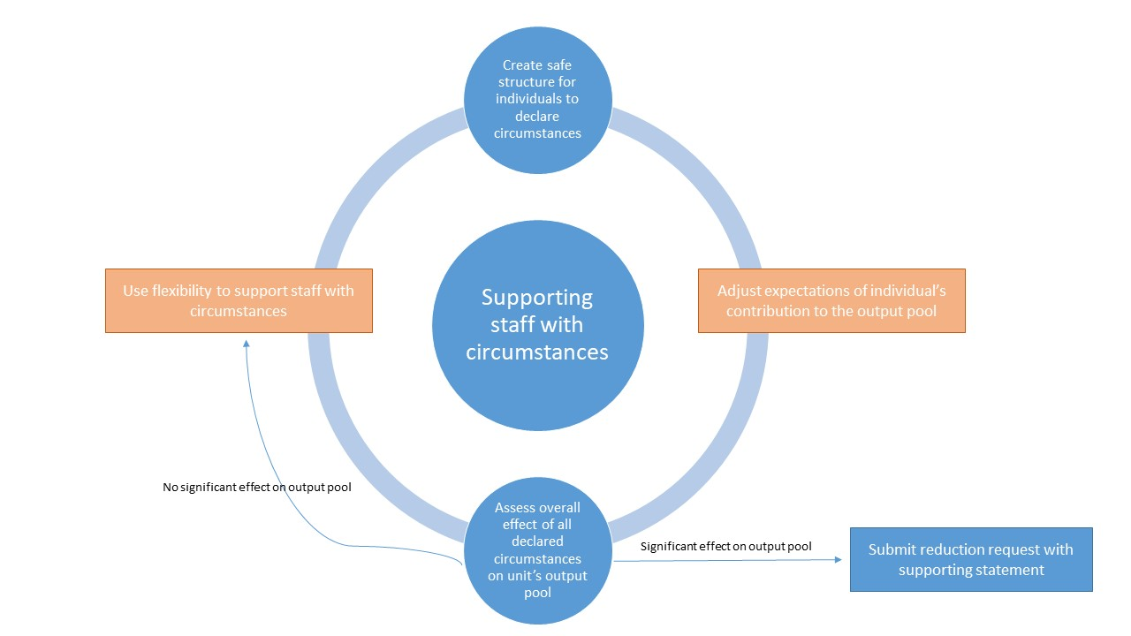

Slide 13
Requesting reductions
Requesting unit reductions:
Where the unit has been disproportionately affected by equality-related circumstances to the extent that flexibility of decoupling is not effective solution
For example:
Small unit with high proportion of staff with circumstances
Disciplines where fewer outputs are traditionally published (e.g. those where monograph is the disciplinary norm)
Would not expect to see, for example, large unit with >100 staff seeking reduction of 2 outputs (unless linked to min. one removal request)

Slide 14
Requesting reductions
Removing the requirement of min. one output:
Where an individual has not been able to produce an eligible output
AND
Any of the following circumstances apply within the period 1 January 2014 to 31 July 2020:
overall period of min. 46 months from research due to one of more of the applicable circumstances
circumstances equivalent to 46 months or more absence from research, where circumstances set out in paragraph 160 apply (such as mental health issues, caring responsibility, long-term health conditions) or
two or more qualifying periods of family-related leave.

Slide 15
Requesting reductions – data
Removing the min. one:
HESA ID (or staff identifier)
Applicable circumstance(s)
Brief statement (max. 200 words)describing effect of circs on individual’s ability to produce an output

Slide 16
Requesting reductions – data
Unit circumstances:
Each set of applicable circumstances (e.g. ECRs who started after 1 August 2018)
No. of staff with each type of circumstances
HESA IDs (or staff identifiers) of all staff with each type of circumstances
(For circumstances requiring a judgement) a brief outline of the nature of the circs and how requested reduction was calculated
Requests can be adjusted at the point of submission to take account of staff changes – approvals will come after submission.
Supporting statement to include info. on:
Context of unit (e.g. size, proportion of staff with declared circs) How the circs affected the unit’s overall output pool How the request complies with the HEI’s code of practice

Slide 17
Applying reductions
Step one
Determine where any request to remove min. of one output is required, apply reduction of one
Determine reductions applying to individual staff (up to 1.5) and sum these across unit
Add reductions from step one and apply rounding to give total for reduction
Ensure request does not reduce output pool below required min of one
Step two
Step three
Step four

Slide 18
Worked example
61 outputs
Unit of 32 staff
Reduction = 3
3 individs with 46+ months circs and no outputs
Unit reduction = 6.5
Total reduction = 9.5
Rounding = 10
3 x circs equating to 46+ months = 4.5
24.3 FTE
51 outputs
Min of 1 required for 29 staff
22 further outputs required
Outputs required:
24.3 x 2.5 = 60.75
Rounding
Request removal of min of 1
2 x 1 family leave period = 1
2 x ECRs (btw 1/8/16 and 31/7/17) = 1

Slide 19
Worked example
36 outputs
Unit of 18 staff
Reduction = 1
1 individ with 46+ months circs and no outputs
1 x circs equating to 46+ months
14.5 FTE
35 outputs
Min of 1 required for 17 staff
18 further outputs required
Outputs required:
14.5 x 2.5 = 36.25
Rounding
Request removal of min of 1
3 x ECRs (btw 1/8/16 and 31/7/17)
Decision not to request unit circs

Slide 20
Circumstances report
Aims to capture:
Full extent of staff circumstances
HEIs’ approaches to requesting unit reductions
Extent to which flexibility of decoupling can effectively support staff with circs
To be submitted after 27 November (to take into account any late adjustments)
Primarily for analysis purposes

Slide 21
Live webinar
The live webinar will take place at 12 noon on Wednesday 13 February.
Visit https://www.ref.ac.uk/events/codes-of-practice-and-staff-circumstances-webinars/ for further details and to register to attend.
We are inviting questions in advance on codes of practice, staff circumstances and EIAs. Please submit your questions by 10 February at https://www.smartsurvey.co.uk/s/refcopwebinar/.
We will also be taking live questions throughout the webinar.

Slide 22
Codes of practice workshops
Places are still available at events in Birmingham (18 February) and Glasgow (25 February). Visit https://www.ref.ac.uk/events/codes-of-practice-workshops-february-2019/ for further information and to register to attend.

