Slide 1




REF 2021 – an update
Follow us on Twitter
@REF_2021
Email us: info@ref.ac.uk

Slide 2

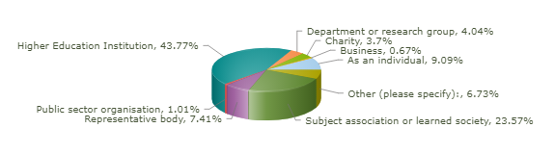
2018 consultation on guidance and criteria
294 respondents
Views sought on clarity – broad agreement (70% +) across most areas
Some areas showing well over 80% agreement
Not always good indicator of feedback!
Mixed views on key issues

Slide 3
Key changes
Guidance on submissions
Approach to taking account of staff circumstances
Additional clarification on research independence and significant responsibility
Eligibility of staff in non-UK based units
Eligibility of outputs by former staff made redundant
Version of output returned (former staff)
Returning co-authored outputs more than once in same submission
Tolerance band for open access
Word limit for institutional level environment statement

Slide 4
Key changes
Panel criteria
Research independence
Co-authorship statements
Double weighting
Continued impact case studies
Increased focus on equality and diversity in environment

Slide 5
Staff submission
All staff with significant responsibility for research should be returned to the REF
- ‘Teaching and Research’ or ‘Research only’
- Independent researcher
- Minimum of 0.2 FTE
- Substantive connection
Accurately identifies staff with significant responsibility for research
100 per cent returned
Some T&R staff do not have significant responsibility for research
Staff with significant responsibility returned, following process developed, consulted on and documented
Category A eligible
Category A submitted
Approach may vary by UOA where employment practices vary at this level

Slide 6
More on eligibility
Substantive connection
Statement required for staff on 0.20-0.29 FTE
  evidence of participation in and contribution to the unit’s research environment
  evidence of wider involvement in the institution
  evidence of research activity focused in the institution
  period of time with the institution
Statement not required where particular personal and discipline-related circumstances apply

Slide 7
Staff in non-UK based units
Staff employed by the UK HEI and based outside the UK will be eligible if the primary focus of their research activity on the census date is clearly and directly connected to the submitting unit based in the UK.
HEIs should use guidance on demonstrating a substantive connection to help determine whether they are eligible
Eligible staff should be returned to HESA. REF team is working with HESA to update their guidance.

Slide 8
Independent researchers
‘An individual who undertakes self-directed research, rather than carrying out another individual’s research programme’
Research assistants / associates not normally eligible
GOS includes generic indicators, including:
  Being named as principal investigator
  Holding an independently won, competitively awarded fellowship where research independence is a requirement. (List at www.ref.ac.uk/guidance)
  Leading a research group or a substantial or specialised work package.

Slide 9
Significant responsibility
Staff for whom:
Explicit time and resources are made available…
proportion of time allocated for research, as determined in the context of the institution’s practices and applied in a consistent way
research allocation in a workload model or equivalent.
…to engage actively in independent research…
eligibility to apply for research funding as the lead or co-applicant
access to research leave or sabbaticals
membership of research centres or institutes within the HEI.
…and that is an expectation of their job role.
current research responsibilities as indicated in, for example, career pathways or stated objectives
expectations of research by role as indicated in, for example, job descriptions and appraisals.

Slide 10
Staff circumstances
Clear feedback from 2016 REF consultation that we need measures to take account of individual circumstances
Decisions document (Nov 2017) set out two measures:
  Reducing no. of outputs required for units with high proportions of staff with individual circumstances
  Removing min. of one output requirement for those with exceptional circs
During development, significant concerns that approach based on effects of circumstances on unit’s overall output pool, rather than on individual contributions to it, not sufficient to ensure E&D fully supported

Slide 11
Key principles
Ensure recognition of the effect circumstances can have upon an individual
researcher’s productivity.
Create the right incentives for HEIs to support staff with circumstances (and avoid introducing negative incentives, for example around recruitment).
Recognise the potential disparity in the available output pool for units in particular contexts, for example where there are high proportions of staff with circumstances.
Maintain the integrity of exercise – both in supporting equality and diversity and ensuring the credibility of assessment process.
Focus on HEIs’ responsibility to support staff with circumstances
Empower individuals to declare their circumstances

Slide 12
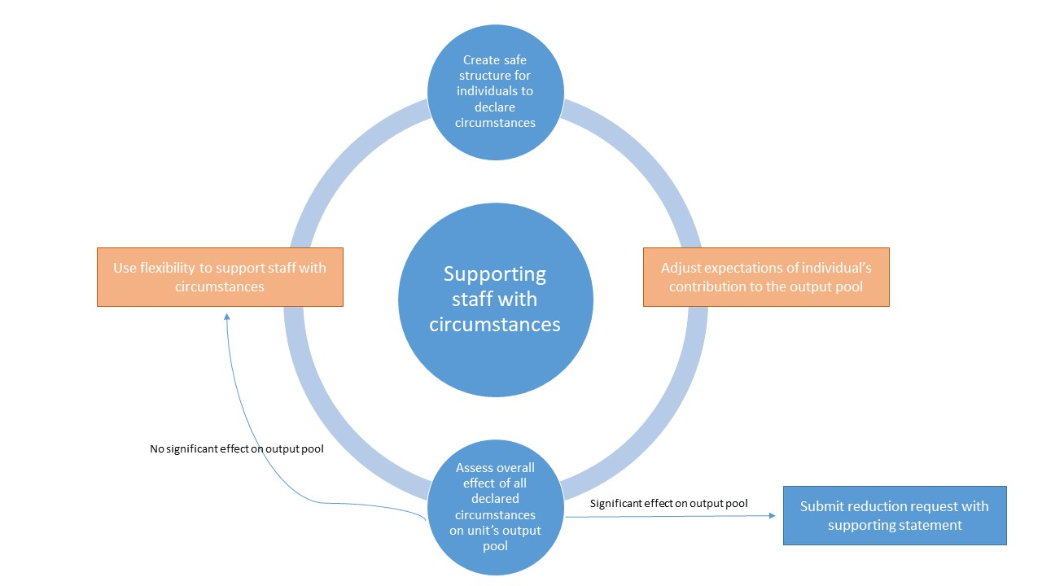

Slide 13
Staff circumstances – reductions
Up to 1.5 output reduction per staff member
More simplified approach to submitting information – requests at unit, not individual, level
Reduction in unit’s required no. of outputs
Removal of minimum of one output
Exceptional circumstances where the individual has not been able to produce an output
Optional reduction in output requirement where staff have not been able to research productively due to individual circumstances. Defined reductions for:
Unit’s output requirement will be further reduced by one
Early career researchers
Plus circumstances equivalent to absence that require a judgement
Individual may be returned without min. of one output
Clinical lectureships
Family-related leave
Secondments/career breaks

Slide 14
Codes of practice
Process for ensuring a fair approach to selecting outputs, incl. those of former staff
Process(es) for identifying staff with significant responsibility for research (where not submitting 100%)
Code of practice to cover:
Process(es) for determining who is an independent researcher
Guidance on codes of practice, including template at www.ref.ac.uk.
EDAP has examined the codes and advised the funding bodies.
Publication intended early 2020.
HEIs will need to provide final versions in early 2021.

Slide 15
Outputs– decoupling
Number of outputs per submission
Output pool to include
FTE of Cat A submitted
2.5
Number of outputs
Submitted outputs
Min of 1 per Cat A submitted
Max of 5 attributed to individuals
May include outputs of staff that have left

Slide 16
Outputs – non-portability
Outputs may be submitted by:
  the institution employing the eligible staff member on the census date; and
  the institution employing the eligible staff member when the output was first made publicly available
For former staff:
  Includes: for staff still employed, but no longer on eligible contract, outputs produced while employed as eligible; and outputs of staff on secondment / leave of absence
  Excludes: any outputs produced before / after period of eligible employment; outputs by staff still on Cat A contracts but who no longer have significant responsibility for research.

Slide 17
Outputs – non-portability
Redundancy
  Funding bodies consulted on whether HEIs should be able to submit the outputs of former staff who have since been made redundant
  Very mixed responses – opinion split almost 50/50
  Concerns raised by those against the proposal:
    Would affect those on fixed-term contracts, incl. ECR research fellowships. Creates disincentive for HEIs to invest in these fellowships if unable to return outputs.
    Could have a negative effect on future career prospects of those made redundant if they couldn’t point to outputs submitted to REF
    Would require HEIs to share sensitive confidential data on who has been made redundant with academic departments
  Require HEIs to set out approach to submitting outputs of former staff, incl. those made redundant, in the code of practice and the UOA environment statement

Slide 18
Outputs – version
Proposed in draft guidance that HEIs submitting outputs of former staff must submit the version that was made publicly available when they were employed by that institution
Feedback from sector and consultation with panels revealed preference for submitting final version
Concerns that it is not always possible to identify the final version (e.g. for practice outputs)
HEIs can submit either version made available during employment or final version

Slide 19
Co-authored outputs
Submitting more than once:
Consulted on whether HEIs should be able to submit an output more than once in a submission to a UOA
Mixed response from sector – suggested disciplinary differences might be justified
Main Panels A-C will not permit this
Main Panel D will permit submission up to two times. Such outputs may make up max. 5% of submission. Cannot be combined with double-weighting
Contribution information:
Appetite expressed in consultation for alignment between MPs A and B
Agreed to follow same process and reached compromise position of 15 authors (increase from 6 in MP A and decrease from 25 in MP B)
Further reflection in MP B revealed that this was only necessary in SP 9 (Physics) – other SPs will not require a contribution statement

Slide 20
Double-weighting outputs
Alignment of criteria in Main Panels C and D
Removal of reference to the ‘disciplinary norm’
Expectation that most books will warrant double-weighting BUT this is not automatic
Suggestion in consultation that HEIs should submit a ranked list of reserve outputs, rather than linking them to specific outputs
Panels agreed that this was unnecessarily complicated

Slide 21

Outputs – open access
Outputs deposited as soon after the point of acceptance as possible, and no later than three months after this date from 1 April 2018.
Deposit exception from 1 April 2018 – outputs remain compliant if they are deposited up to three months after the date of publication.
Additional flexibility – 5% tolerance band (or one output) per submission to a UOA

Slide 22
Impact
Consistency with REF 2014
Impact remains non-portable
2* quality threshold
Timeframe:
1 January 2000 - 31 December 2020 for underpinning research
1 August 2013 - 31 July 2020 for impacts
Refinements
Impact template integrated into Environment statement
Impact on teaching within (and beyond) own HEI is eligible
Enhanced clarity on scope of underpinning research – bodies of work
Enhanced guidance on public engagement
Guidance on submitting continued impact case studies

Slide 23
Impact – criteria
Reach
the extent and/or diversity of the beneficiaries of the impact, as relevant to the nature of the impact. (It will not be assessed in geographic terms, nor in terms of absolute numbers of beneficiaries.)
Significance
the degree to which the impact has enabled, enriched, influenced, informed or changed the performance, policies, practices, products, services, understanding, awareness or well-being of the beneficiaries.
Case studies describing any type(s) of impact welcomed (extensive – but not exhaustive – list of examples of impact and indicators at Annex A)
Case studies describing impacts through public engagement welcomed
Case studies must provide a clear and coherent narrative supported by verifiable evidence and indicators
Panel expectations in relation to receiving continued case studies
Additional guidance on impacts on teaching within the submitting HEI

Slide 24
Impact – underpinning research
Panels recognise that the relationship between research and impact can be indirect and non-linear
Underpinning research as a whole must be min. 2* quality
Case studies must include up to six key references (not every output referenced has to be 2*) – HEIs can consult the outputs glossary in the Guidance on submissions
Can also include indicators of quality e.g. evidence of peer-reviewed funding, prizes or awards for individual outputs etc.
May be a body of work produced over a number of years or may be the output(s) of a particular project
Must be produced by someone working at the HEI within the scope of the UOA descriptor
  Does not need to be a Category A eligible staff member
  Impact case study can be returned to different UOA from the outputs that underpin it

Slide 25
Environment template
Sections
Unit context, research and impact strategy.
People, including:
  staffing strategy and staff development
  research students
  equality and diversity.
Income, infrastructure and facilities.
Collaboration and contribution to the research base, economy and society.
Information about the unit’s support for impact to be included across the four sections

Slide 26
Environment template
Weighting
Main Panel A, B and C will attach equal weighting to each of the four sections
Recognising the primary role that people play as the key resource in the arts and humanities, Main Panel D will attach differential weight to sections:
  Unit context and structure, research and impact strategy (25%)
  People (30%)
  Income, infrastructure and facilities (20%)
  Collaboration and contribution to the research base, economy and society (25%)

Slide 27
Institutional level assessment of environment
Institutional-level information will be appended to the UOA-level environment template and will be taken into account by the sub-panel when assessing the unit-level statement.
Pilot of the standalone assessment of the discrete institutional-level environment will draw on this submitted information.
Outcomes from the separate pilot exercise will not be included in REF 2021 but will inform future research assessment.
Increase in word limit to min. 4,000 words.
Further guidance and criteria were published in September 2019 following consultation.

Slide 28
Survey of submission intentions
HEIs submitted their intentions in December 2019
Significant increase in FTE since REF 2014 (43%), as expected
Similar number of outputs and case studies to 2014
Increases show variation by MP, with greatest increases expected in Main Panel C's areas
Main Panel | Anticipated FTE in REF 2021 | Submitted FTE in REF 2014 | Percentage change
A | 19,573 | 13,611 | 43.8%
B | 17,956 | 13,352 | 34.5%
C | 23,194 | 14,415 | 60.9%
D | 13,861 | 10,698 | 29.6%

Slide 29
Forward look 2020
System development
Assessment phase preparation
Panel meetings
Launch of live subs system
Development of assessment systems
Testing and training for assessment systems
Warehouse operational
Supporting submissions
Queries, FAQs
Releases of contextual data
Further REF4 data
Reduction requests advance process
User support and guidance
Finalise panel appointments

Slide 30
Timetable
Early 2020 | Formal release of the submission system Invitation to HEIs to make submissions Publication of approved codes of practice Call for nominations for further panel members & assessors Deadline for staff circumstances requests
Mid 2020 | Appointment of panel members & assessors for assessment phase Feedback to HEIs on advance staff circumstances requests
31 July 2020 | Census date for staff End of assessment period (for impact, environment, and data about research income and research doctoral degrees awarded)
27 November 2020 | Closing date for submissions

Slide 31
Further information
www.ref.ac.uk (includes all relevant documents and FAQs)
Webinars on EIAs and staff circumstances: https://www.ref.ac.uk/events/codes-of-practice-and-staff-circumstances-webinars/.
Enquiries from staff at HEIs should be directed to nominated institutional contact (available at www.ref.ac.uk/contact)
Other enquiries to info@ref.ac.uk

